Slide 1




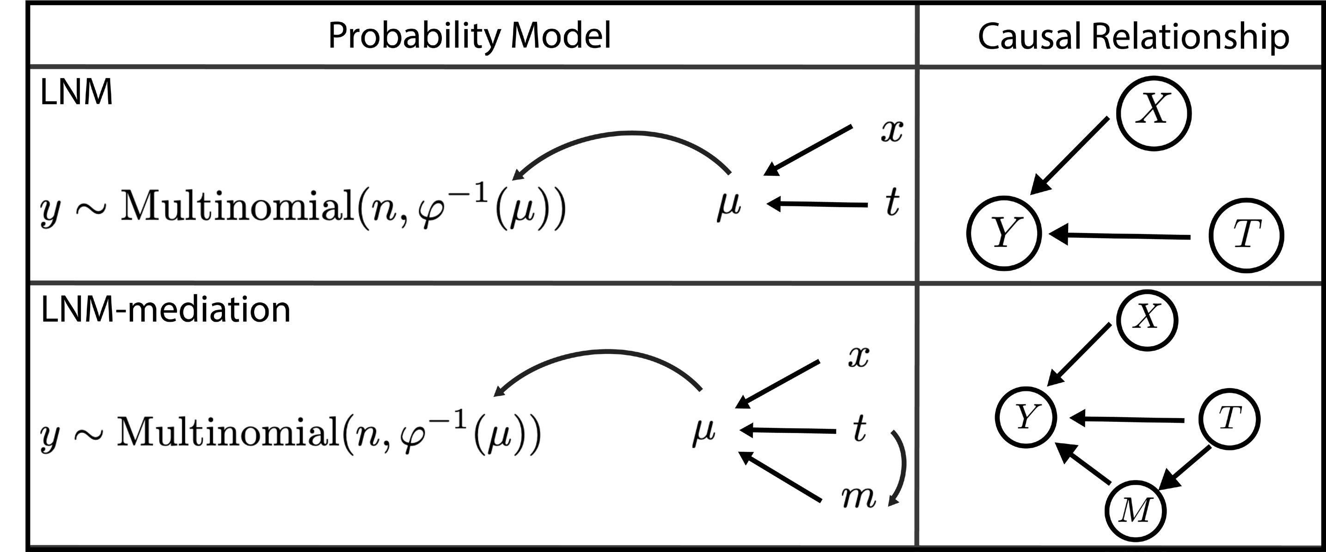
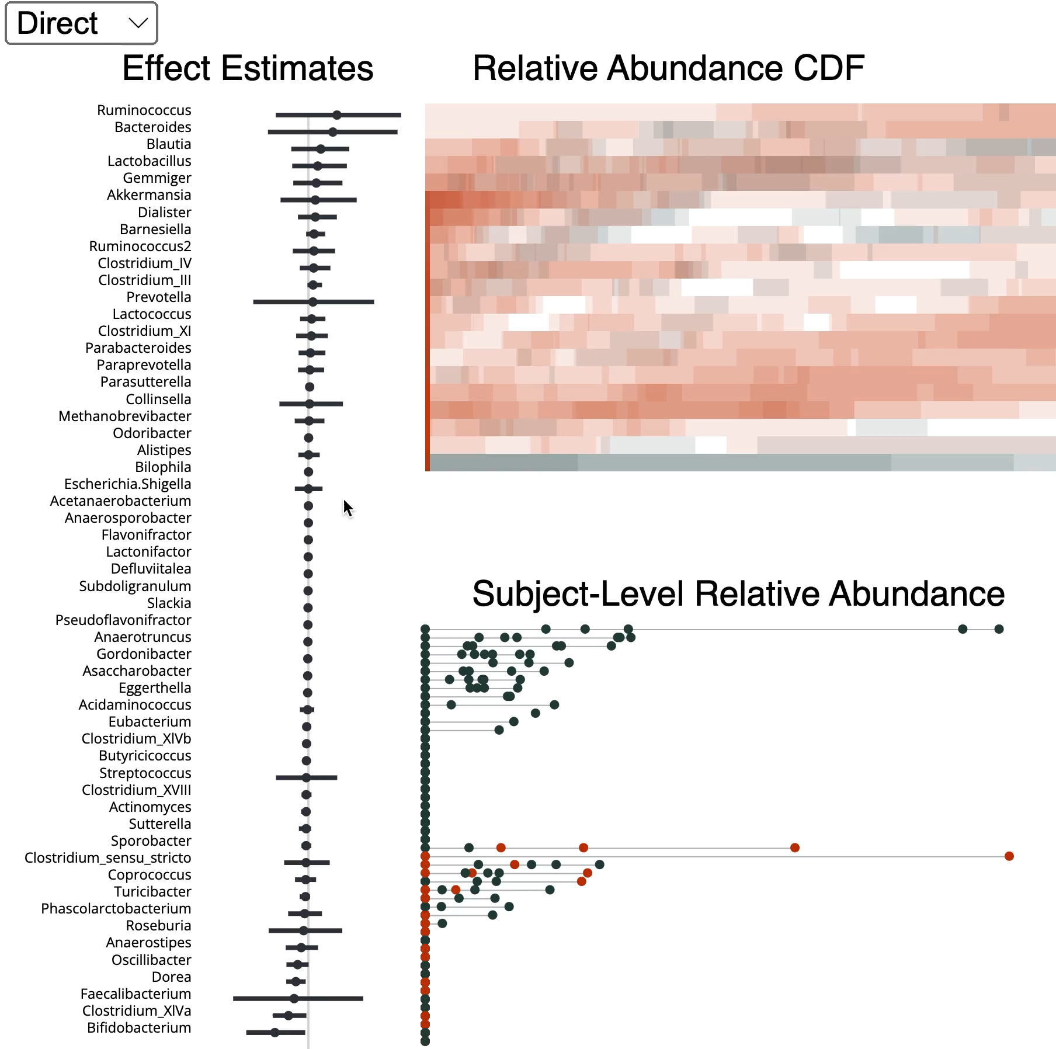


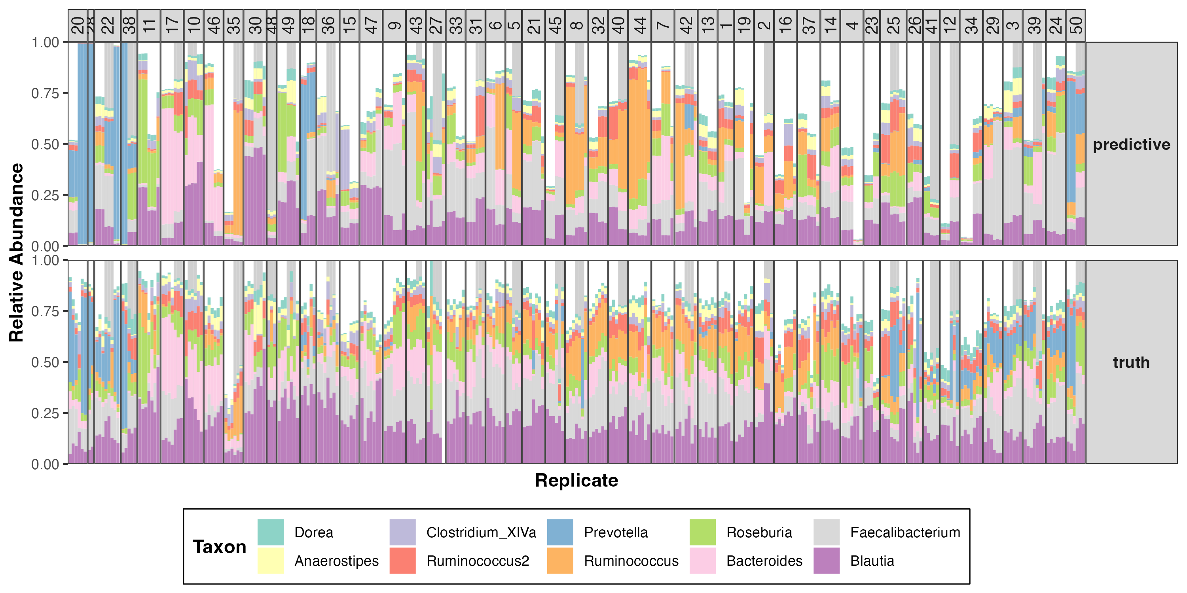


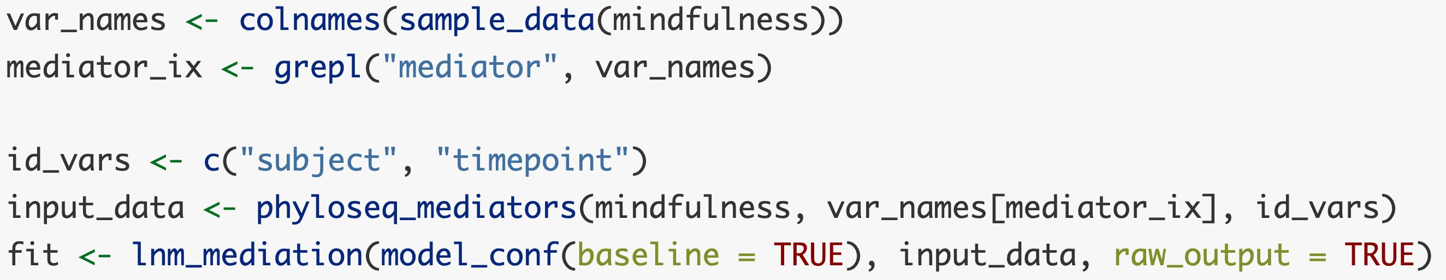

Generative Models for Microbiome Mediation Analysis
Xinran Miao^{1*}, Hanying Jiang^{1*}, Mara Beebe², Margaret W. Thairu², Dan W. Grupe³, Richard J. Davidson^{3,4,5}, Jo Handelsman^{2,6}, and Kris Sankaran^{1,2}
* Equal contribution
1: Department of Statistics
2: Wisconsin Institute for Discovery
3: Center for Healthy Minds
4: Department of Psychology
5: Department of Psychiatry
6: Department of Plant Pathology
Introduction
Descriptive statistical methods have played a major role in microbiome studies, but emerging microbiome engineering problems require counterfactual analysis.
We establish a method to disentangle direct from indirect intervention effects using counterfactual mediation [1] and logistic-normal multinomial [2] analysis. A case study finds that mindfulness’ effect on the microbiome cannot be explained by diet change alone.
Simulation
Model selection can be guided by semisynthetic simulation. We use a Zero-Inflated Nonnegative Quantiles [4] to generate data with ground truth effects. This model fits marginals well and helps determine effect thresholds to calibrate inference.
Case Study
Notation
We consider a new dataset gauging associations between the gut microbiome and mindfulness [5]. Our team proﬁled microbiome composition, psychological symptoms, and behaviors among subjects before and after a mindfulness training.
We use diet and sleep as potential mediators. We show goodness-of-fit and estimated effects. The absence of significant indirect effects suggests simple behavioral changes are not responsible for microbiome shifts.
Methodology
The LNM-mediation model is built from two regressions. The first is a linear mediation model between treatment and mediators. The second, the outcome model, applies a logistic-normal mul- tinomial link. Each sample is treated as a multinomial whose underlying probability is the inverse log-ratio transformation of a parameter depending on the treatment and mediators.
Abundance
Indirect effect
Direct effect
The fitted counterfactual compositions inform direct and indirect effect estimates
Diet
Software
We have developed an R package to estimate, evaluation, and visualize LNM-mediation models. The snippet to the right fits a model using a phy- loseq object [3] as input.
References
Imai, K., Keele, L.J., & Tingley, D. (2010). A General Approach to Causal Mediation Analysis. Political Methods: Quantitative Methods eJournal.
Xia, F., Chen, J., Fung, W.K., & Li, H. (2013). A Logistic Normal Multinomial Regression Model for Microbiome Compositional Data Analysis. Biometrics, 69.
McMurdie, P.J., & Holmes, S.P. (2013). phyloseq: An R Package for Reproducible Interactive Analysis and Graphics of Microbiome Census Data. PLoS ONE, 8.
Ling, W., Zhao, N., Plantinga, A.M., Launer, L.J., Fodor, A.A., Meyer, K.A., & Wu, M.C. (2021). Powerful and robust non-parametric association testing for mi- crobiome data via a zero-inflated quantile approach (ZINQ). Microbiome, 9.
Grupe, D.W., Mcgehee, C.R., Smith, C., Francis, A.D., Mumford, J.A., & Davidson, R.J. (2019). Mindfulness Training Reduces PTSD Symptoms and Improves Stress-Related Health Outcomes in Police Officers. Journal of Police and Criminal Psychology, 36, 72-85.
Support

